Slide 1
Cloud Computing
SEWP ZG527
Notes:
RL 3.4

Slide 2
VM Migration

Slide 3
Virtual Machine Migration Services
Migration service -
The process of moving a virtual machine from one host server or storage location to another;
There are different techniques of VM migration-
- Hot/live migration,
- Cold/regular migration, and
- Live storage migration of a virtual machine.
In this process, all key machines’ components, such as CPU, storage disks, networking, and memory, are completely virtualized, thereby facilitating the entire state of a virtual machine to be captured by a set of easily moved data ﬁles.
Notes:
RL 3.5

Slide 4
Cold/regular migration
Cold migration is the migration of a powered-off virtual machine and is done in the following tasks:
If the option to move to a different datastore was chosen, the configuration files, including the NVRAM file (BIOS settings), and log files are moved from the source host to the destination host’s associated storage area. If you chose to move the virtual machine's disks, these are also moved.
The virtual machine is registered with the new host.
After the migration is completed, the old version of the virtual machine is deleted from the source host if the option to move to a different datastore was chosen.

Slide 5
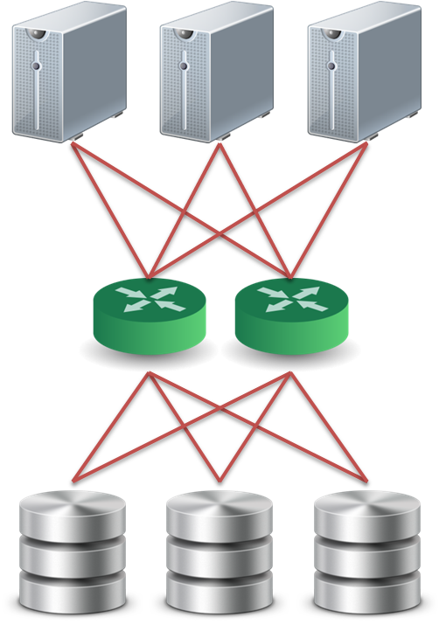
Live Migration Technique
Pre-assumption :
We assume that all storage resources are separated from computing resources.
Storage devices of VMs are attached from network :
NAS: NFS, CIFS
SAN: Fibre Channel
iSCSI, network block device
drdb network RAID
Require high quality network connection
Common L2 network (LAN)
L3 re-routing
VM 1
VM 2
VM 2
Disk
VM 1
Disk

Slide 6
Live Migration Technique
Challenges of live migration :
VMs have lots of state in memory
Some VMs have soft real-time requirements :
For examples, web servers, databases and game servers, ...etc.
Need to minimize down-time
Relocation strategy :
Pre-migration process
Reservation process
Iterative pre-copy
Stop and copy
Commitment

Slide 7
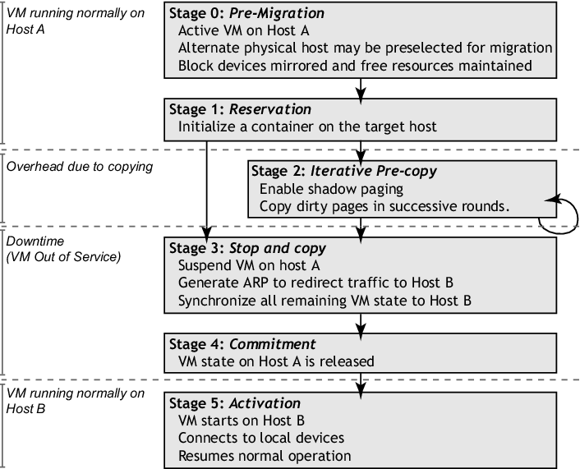
Live Migration Technique

Slide 8

Live Migration Technique
Pre-migration process
Reservation process
VM active on host A
Destination host selected (Block devices mirrored)
Initialize container on target host
Copy dirty pages in successive rounds
Suspend VM on host A
Redirect network traffic
Synch remaining state
Activate on host B
VM state on host A released
Iterative pre-copy
Stop and copy
Commitment

Slide 9
Live Migration Technique
Live migration process :
Pre-copy migration : Round 1,
Enable Shadow Paging
Host A
Host B

Slide 10
Live Migration Technique
Live migration process :
Pre-copy migration : Round 2
Host A
Host B

Slide 11
Live Migration Technique
Live migration process :
Stop and copy : Final Round
Host A
Host B

Slide 12
Live Migration Demo
Using Proxmox deployment tool

